Slide 1



TEAM SUKHOI
"SUKHOI: Precision-engineered financial assistance, guiding you to new heights of prosperity."

Slide 2

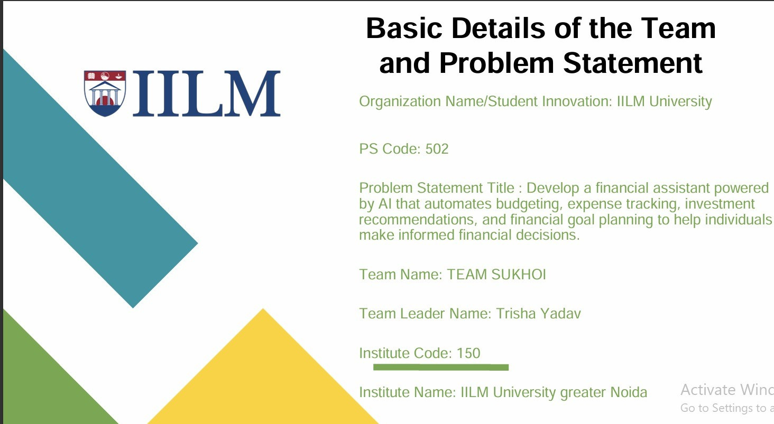
TEAM SUKHOI
INFORMATION
TEAM LEADER
TRISHA YADAV
TEAM MEMBER
ARICHISHA RANJAN
DEVENDER
GAGAN TIWARI
JANVI
TRISHA YADAV

Slide 3
PROBLEM STATEMENT--
DEVELOP A FINANCIAL ASSISTANT POWERED by AI that automates budgeting, expense tracking, investment recommendations, and financial goal planning to help individuals
make informed financial decisions
PROPOSED IDEA--
⮚Our idea is to develop a website with virtual AI assistant that integrates budget automation, expense tracking, investment recommendations and financial goal planning.
⮚After analyzing the customer’s budget and expenditure our website will accordingly offer suggestions and provide solutions
for better investments.
⮚Our idea also expands over the concept of promoting financial literacy by using AI & ML to help customers learn about finance
and earn higher returns than fixed deposits.
⮚Other important thing is that by using the available financial data and after properly analyzing it, we are providing best
financial recommendations in stocks, bonds and commodities.

Slide 4
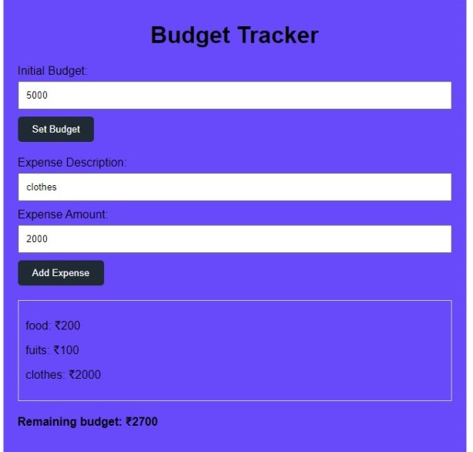
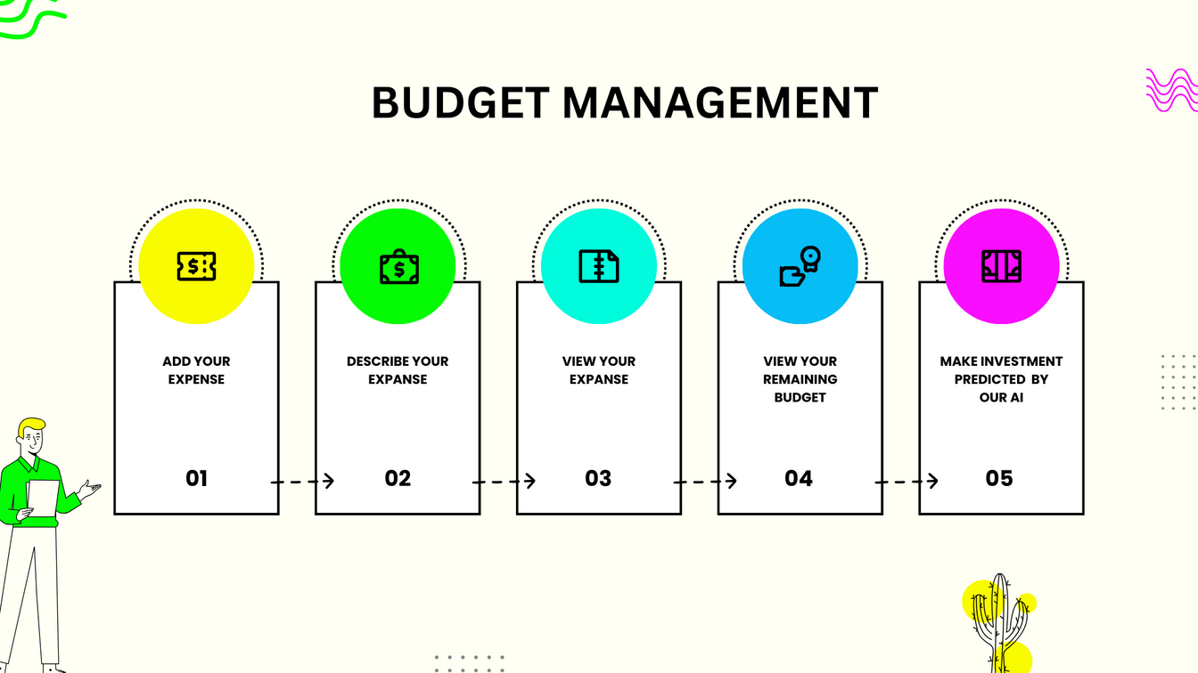
BUDGET TRACKING
BUDGET TRACKER = EXPANSE TRACKER + BUDGET AUTOMATION
BUDGET TRACKER ENABLE YOU TO MONITOR HOW MUCH OF YOUR BUDGET HAS BEEN SPENT OVER THE TIME
IT WILL HELPS TO CREATE FINANCIAL STABILITY
RECOMMANDATION-- 50-30-20 RULE OF INVESTMENT

Slide 5
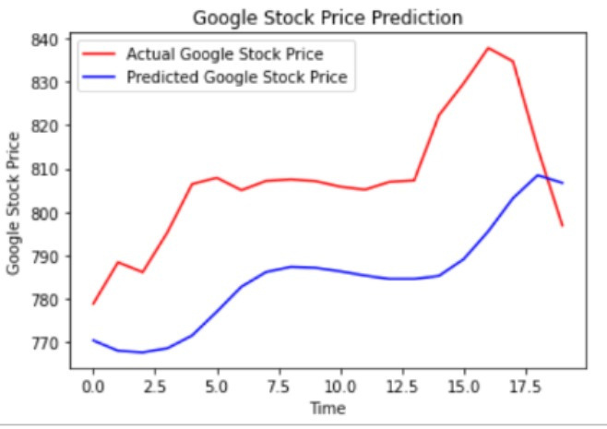
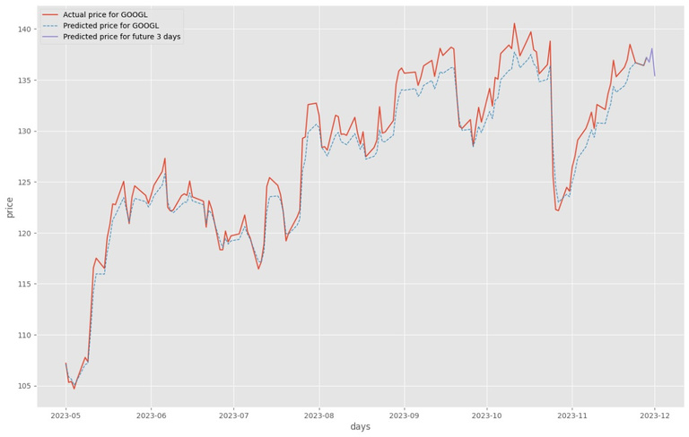
INVESTMENT RECOMMENDATION
Natural Language Processing (NLP):
Implement natural language processing to enable users to interact with the assistant through text or voice commands.
Use NLP to understand user queries and provide appropriate responses or actions.
Budgeting and Expense Tracking:
Integrate with financial institutions or third-party services to automatically fetch transaction data and update users' budgets and expense tracking.

Slide 6






Financial Assistance Roadmap
FINANCIAL
KNOWLEDGE
EXPENSE
TRACKING AND
ANALYZING
BLOGS
YOUTUBE
ARTICLES
O4
O1
O2
O3
BUDGET TRACKING
INVESTMENT
RECOMMENDATION
USING ML FINDING
INVESTMENT OPPORTUNITY
STOCKS
MUTUAL FUNDS
COMMODITIES

Slide 7

CONCLUSION
Utilizing AI algorithms, the financial assistant efficiently automates budgeting, expense tracking, investment recommendations, and financial goal planning.
Through data analytics, personalized investment strategies are generated, considering individual risk profiles and market conditions.
The seamless integration of financial goal planning features empowers users to set and achieve specific objectives, enhancing financial planning.
Overall, the AI-powered financial assistant revolutionizes personal finance management, providing individuals with actionable insights and informed decision-making capabilities

Slide 8

BUSINESS APROACH
FUTURE STACK
MEMBERSHIP
MORE ACCURATE PREDICTION,
MORE INVESTOR CONNECTIVITY
NLPs
CLASSIFICATION OF ALG
DEEPLEARNING

